Slide 1
Sine

Slide 2
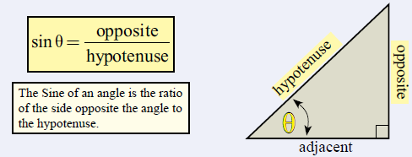
Topic : Sine Ratio
24
7
30
Date
EQ : What is the Sine ratio?
Sine (sin for short).
Exists in right triangles
Uses the ratio of the opposite side ÷ hypotenuse to identify the angle size

Slide 3
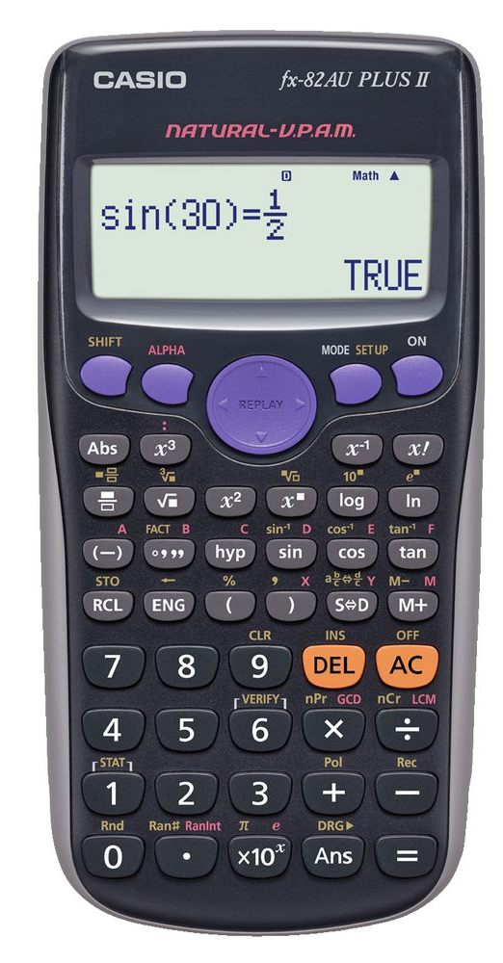
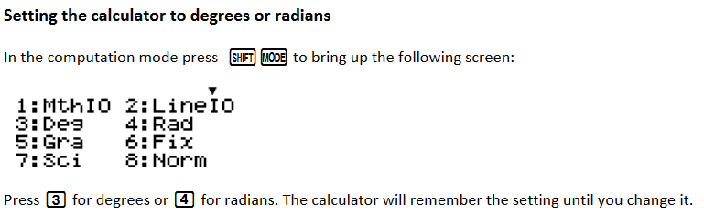
Before using your calculator to calculate angles, make sure it is in “Degrees” mode.

Slide 4


To find the angle….
15cm
7 cm
Ø
Sin Ø = $\frac{opp}{hyp}$
Sin Ø = $\frac{7}{15}$
Sin Ø = 0.467
Using a calculator, press “shift” “sin” 0.467 “=“
Ø = 27.8º

Slide 5




To find the opposite side….
10 cm
$x$cm
25º
Sin Ø = $\frac{opp}{hyp}$
Sin 25 = $\frac{x}{10}$
10 x Sin 25 = $x$
Using a calculator, press 10 “x” “Sin” 25 “=“
$x$ = 4.23 cm

Slide 6




To find the hypotenuse ….
$x$cm
6 cm
50º
Sin Ø = $\frac{opp}{hyp}$
Sin 50 = $\frac{6}{x}$
$x$= $\frac{6}{\sin{50}}$
Using a calculator, press 6 “÷” “Sin” 50 “=“
$x$ = 7.83 cm

Slide 7
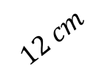




Lets try together.
$$12 cm$$
$$x$$
30º
Sin Ø = $\frac{opp}{hyp}$
Sin 30 = $\frac{x}{12}$
12 x Sin 30 = $x$
press 12 “x” “Sin” 30 “=“
$x$ = 6 cm

Slide 8





Lets try together.
$$x$$
$$3 m$$
70º
Sin Ø = $\frac{opp}{hyp}$
Sin 70 = $\frac{3}{x}$
$x$= $\frac{3}{\sin{70}}$
press 3 “÷” “Sin” 70 “=“
$x$ = 3.2 cm

Slide 9


Lets try together.
$$7m$$
$$3 m$$
Ø
Sin Ø = $\frac{opp}{hyp}$
Sin Ø = $\frac{3}{7}$
Sin Ø = 0.428
press “shift” “sin” 0.428 “=“
Ø = 25.4º

Slide 10
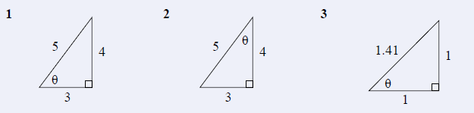
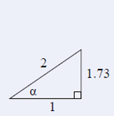
Find the size of the angles.

Slide 11
Find the size of the opposite side
5m
60º
90cm
3m
15º
60º

Slide 12
Find the size of the hyotenusee side
20cm
25º
13m
50º
40º
9cm

